Slide 1
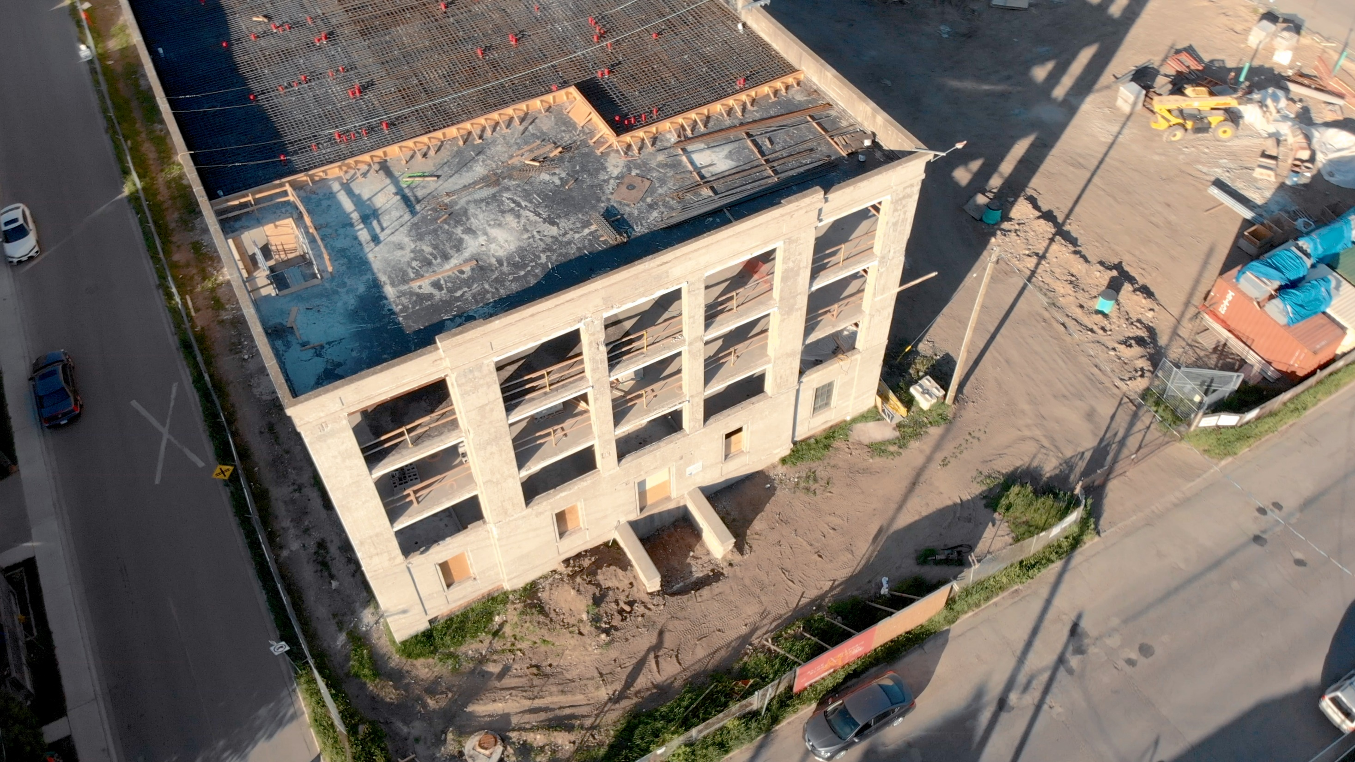


National Construction and Demolition
Circular Innovation Challenge
Overview

Slide 2




Do You Have a New Circular Idea or Innovation?
COIL is looking for new, innovative climate-smart circular ideas in the construction, renovation & demolition (CRD) sector to tackle the challenges of waste, pollution, climate change, and biodiversity loss in Canada.
COIL’s national network will provide funding, mentorship and education through the
National Construction and Demolition Circular Innovation Challenge
in 2023 for the top applicants of three or more organizations to prototype their idea, innovation or approach,
and for one successful team to demonstrate viability and scale in a pilot project up to six months.
Program information is available on www.COIL.eco.
COIL.eco
2

Slide 3
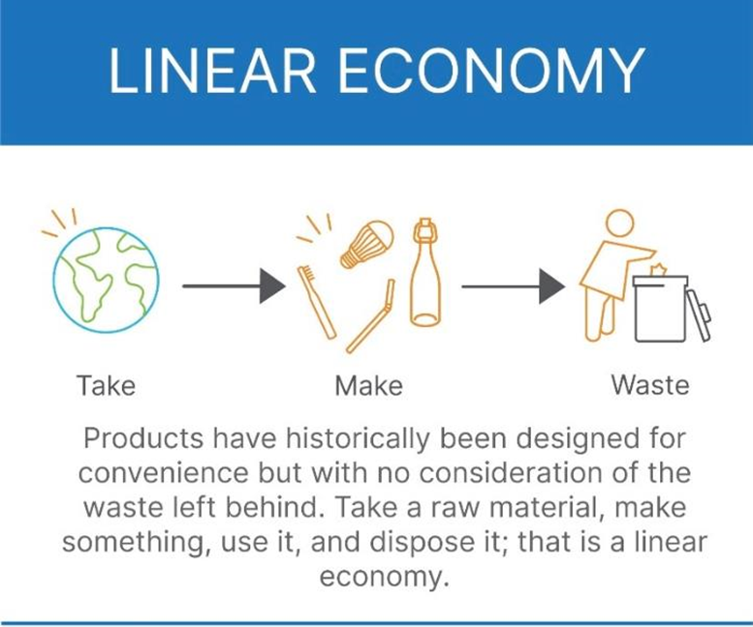
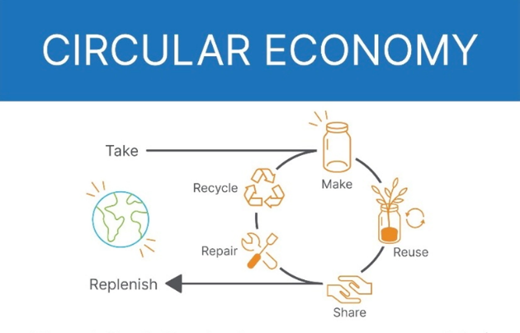
Importance of the Circular Economy
Business benefits
Reduce operating cost and waste
Reduce resource and carbon-intensive energy consumption
Improve competitiveness
Strengthen relationships and brand (customers, employees, suppliers)
Diversify revenues
Mitigate risk (supply chain resiliency)
Systems-solution framework that tackles global challenges
like climate change, biodiversity loss, waste, and pollution.
Based on three principles, driven by design:
eliminate waste and pollution; circulate products and materials (at their highest value); and regenerate nature.
Sources
Circular Innovation Council
Ellen MacArthur Foundation
Environment and Climate Change Canada
COIL.eco
3

Slide 4
National Construction and Demolition
Circular Innovation Challenge
Circular Opportunity Innovation Launchpad (COIL) has launched our National Construction and Demolition Circular Innovation Challenge to encourage the development of new ideas, innovations or approaches to specifically address materials diversion and recovery or reuse, recycling and upcycling challenges in the construction, renovation and demolition (CRD) sector. COIL is seeking collaborative teams of organizations (businesses, not-for-profits, academia, etc) with new thinking to accelerate the climate-smart circular economy (CE).
We have funding available for CRD CE projects that can create systems-level, sector-wide impact and change. The ideas, innovations or approaches should be capable of transforming an industry, or even create a new one.
COIL is looking for teams that want to be Canadian circular economy leaders. Further to funding, mentorship and CE education, accepted participants in our CRD CE challenge will receive promotion across our networks, including at national and/or international forums.
The Ellen MacArthur Foundation reports that the “built environment” uses almost half of all materials extracted from the Earth each year. This challenge is to improve the management of CRD materials from across the supply chain, recovery on construction sites, diversion away from landfill, and to increased reuse, recycling and/or upcycling.
COIL.eco
4

Slide 5
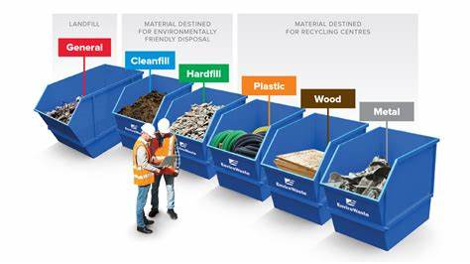
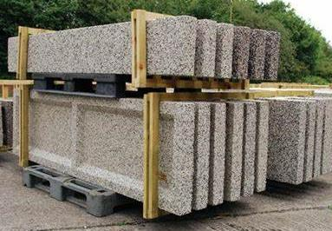
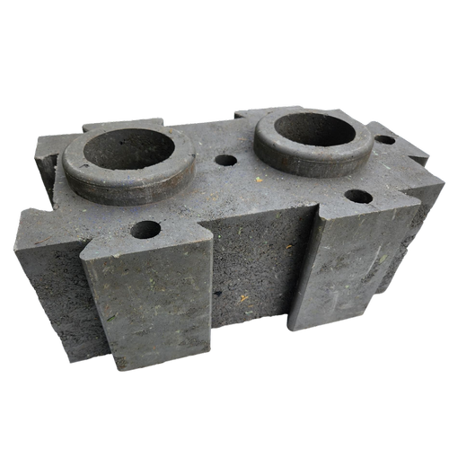
Our Challenge Scope of CRD Circularity
Process Innovation
Increase diversion
and recovery rates
for CRD sector
Material or Market Innovation
Create market demand
and/or infrastructure to increase
material reuse and recycling rates
COIL.eco
5

Slide 6
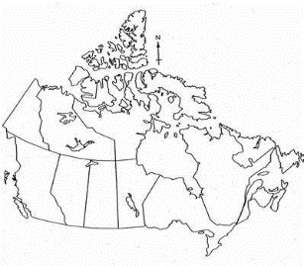
Seeking Climate-Smart Circular Ideas
Three (3) teams will receive $15,000 each to develop their idea/innovation during the prototype phase and one (1) successful team will receive up to an additional $75,000 for a six-month demonstration pilot project
Collaborative team of three or more organizations to submit CRD CE proposal
  Lead applicant of team must be a Canadian small-to-medium enterprise (SME) of less than 500 employees
Potential impact
  Measurable reduction of greenhouse gas (GHG) emissions
  Increase material diversion and recovery rates
  Develop or grow secondary market demand and/or infrastructure to increase material recycling rates
  Reduces costs (or cost neutral) and straightforward to implement so action will be sustained over time
  Extra consideration will be given to ideas or innovations with potential to drive sector change across Canada
Implementation-ready and scalable
Ability to drive systems-level change and sector-wide impact
Project operation, majority of team-members and impact of prototyped/demonstrated innovation must be in the construction, renovation and demolition (CRD) sector in Canada
Matched funding preferred
  Matched funding can include capital, in-kind, commitment to knowledge transfer, etc
COIL.eco
6

Slide 7
Key Program Dates in 2023
Information sessions March 16 (at 12 noon eastern)
April 6 (at 12 noon eastern)
Applications due April 21 (by 8 pm eastern)
Prototype phase May to August
Demonstration pilot project Up to six (6) months starting Aug/Sept 2023
Primary contacts
Christa Clay
Vancouver Economic Commission
cclay@vancouvereconomic.com
Madeline Carter
COIL, Smart Cities Office
madeline.carter@guelph.ca
Patrick Farrar
Halifax Partnership
pfarrar@halifaxpartnership.com
COIL.eco
7

Slide 8
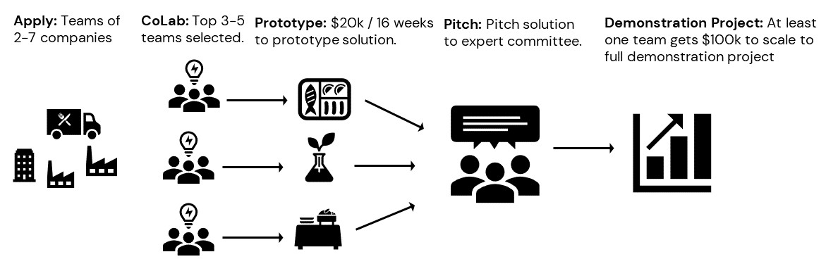
National Circular Innovation Challenge Process
Apply: Teams of 3+ organizations.
Top 3 teams selected.
Prototype: Funding for prototype development phase.
Pitch: Pitch solution to expert committee.
Demonstration: Final funding awarded to top team for demonstration pilot project.
COIL.eco

Slide 9




National Innovation Challenge Support
Primary program funding
Additional funding support
Regional funding
In-kind support
COIL.eco
9

Slide 10




Circular Opportunity Innovation Launchpad (COIL) is an innovation platform and network with the goal to develop, prove and scale transformative solutions that will move Canada toward a climate-smart circular economy. It contains a comprehensive suite of programs, tools and resources developed to embed and accelerate circularity through businesses and organizations, as well as across supply chains and material streams. COIL is currently developing a national circular economy network in collaboration with Vancouver Economic Commission and Halifax Partnership.
COIL is an initiative of the City of Guelph, in collaboration with the County of Wellington and program-delivery partners. COIL is funded in part by the Government of Canada through the Federal Development Agency for Southern Ontario, as well as by corporate supporters.
Please follow @COIL_CE
COIL.eco

